Slide 1

Insurance Analytics
GROUP 2
Cheetiralla Veera Bharath
SIRHAN ANIS CHAUS
Parmeet Singh Jassal
Kirti Nishad

Slide 2

Introduction
Project Overview :
This project aims to analyze the insurance industry Data .This presentation provides an analysis of the branch's performance by Account Executives for different income classes. It includes a review of key metrics such as Cross sell, Renew and New, Invoice Details, financial performance and Opportunity by employees of Ahmedabad branch.
Objectives:
Review the performance metrics. Most read
Identify trends and anomalies.
Highlight areas of improvement and success.
Create Dashboard in Excel, Power BI, Tableau, SQL query for KPI'S.
Notes:
Tools USed

Slide 3
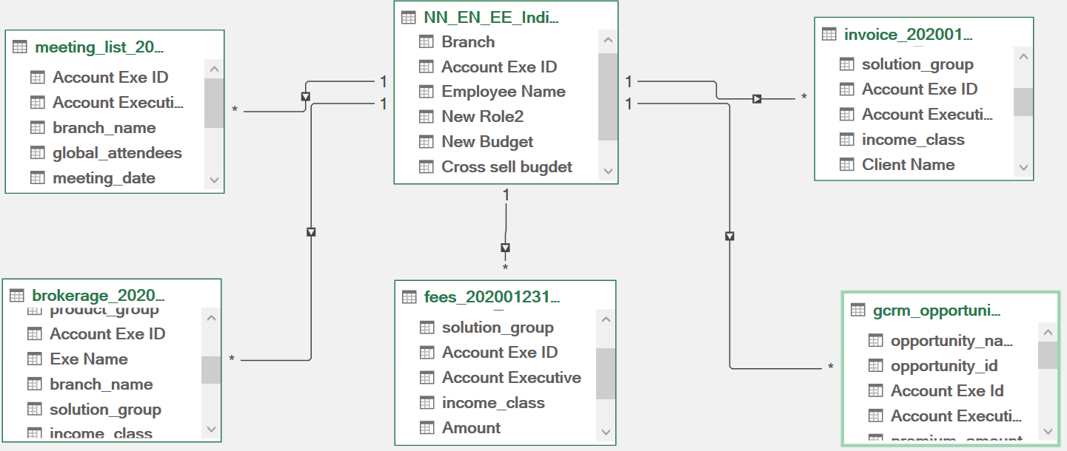

Relations
Notes:
Relationships

Slide 4
Key Performance Indicators (KPIs)
KPIs Tracked using the Data Source
Cross-sell, new, Renewal: calculation of Target, invoice, achieved by income class and cross sell, New, Renewal placed and invoice achievement percentage.
Number of Meeting: Calculation of meeting count for 2019,2020.
Opportunity: calculation of total opportunity, total open opportunity, top open opportunity, and opportunity by product distribution.
Revenue: opportunity by revenue top 4,Revenue by stage (Qualify Opportunity, Negotiate, Propose Solution)5.Account Executive: Meeting count by Account Executive, Number of invoice generated by Account executive (filtered by income class)Present a comparative analysis of target KPIs versus actual performance for the period.

Slide 5
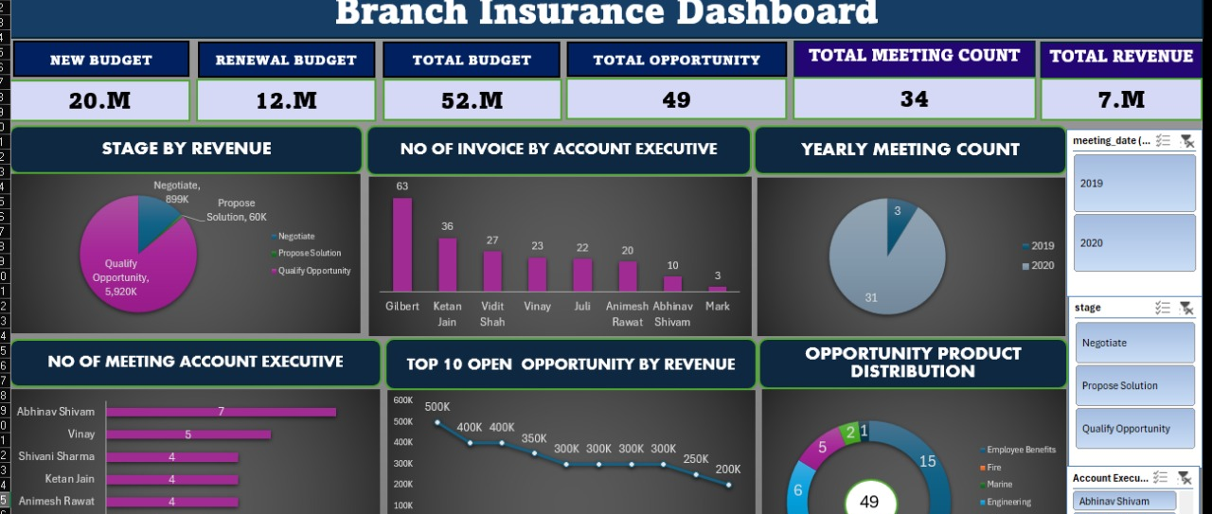
EXCEL DASHBOARDS

Slide 6
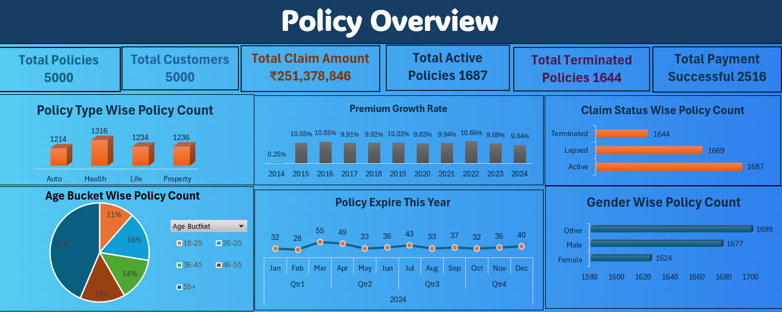

Slide 7
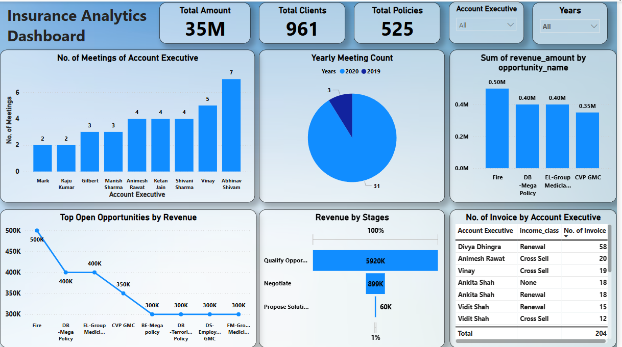
POWER BI DASHBOARDS
Notes:
POWER BI DASHBOARDS

Slide 8
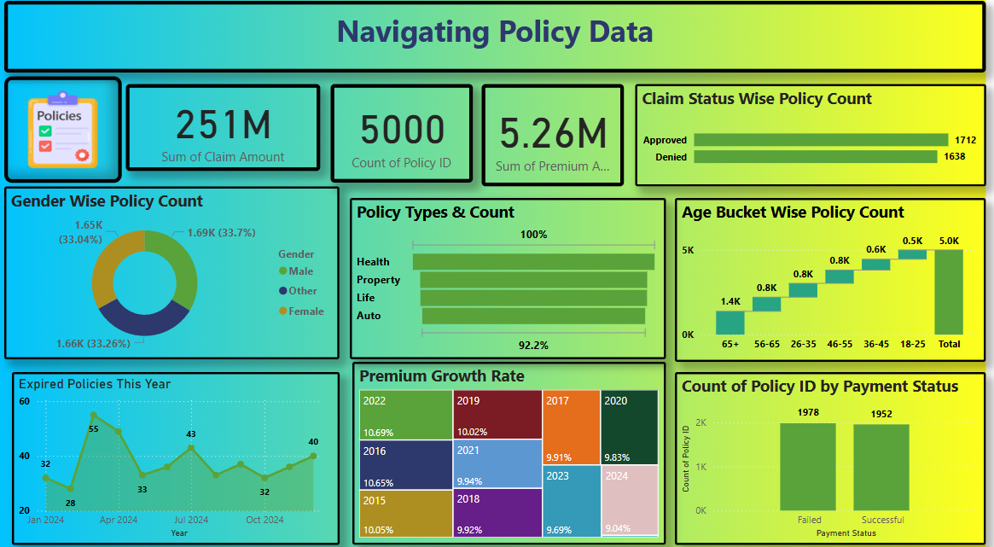

Slide 9
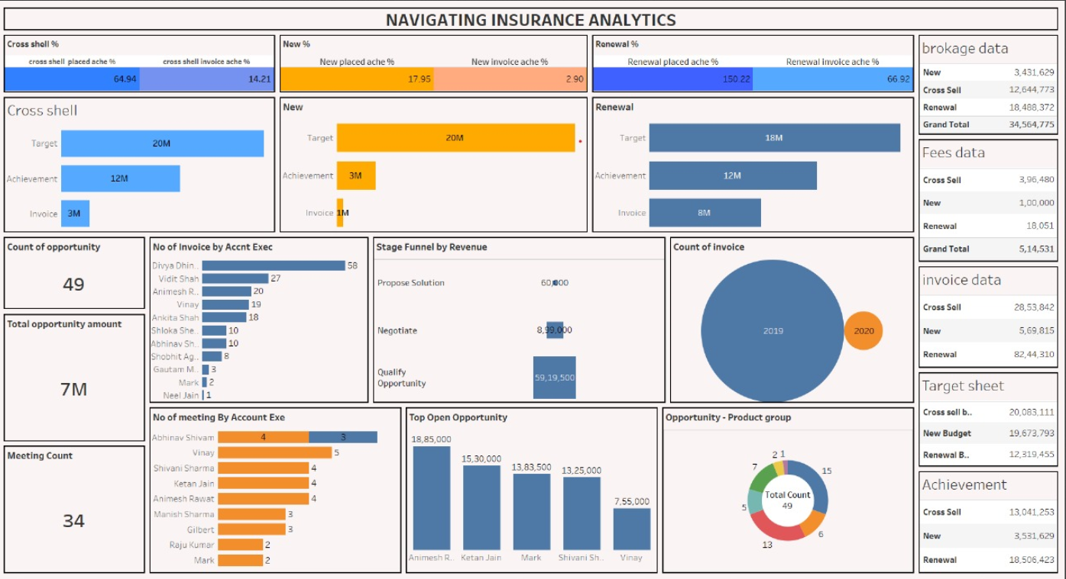
TABLEAU DASBOARDS

Slide 10
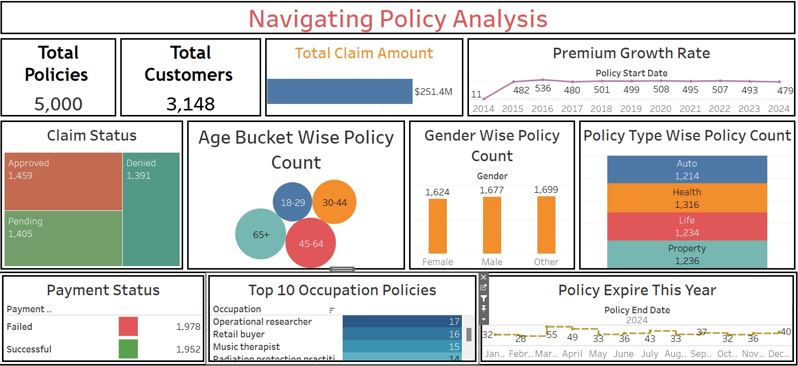

Slide 11
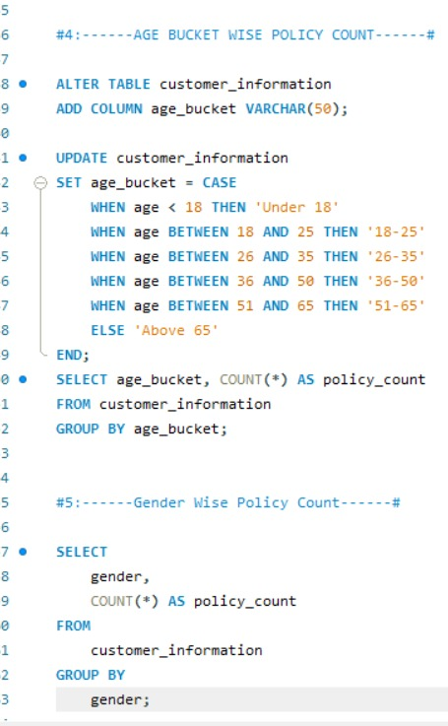
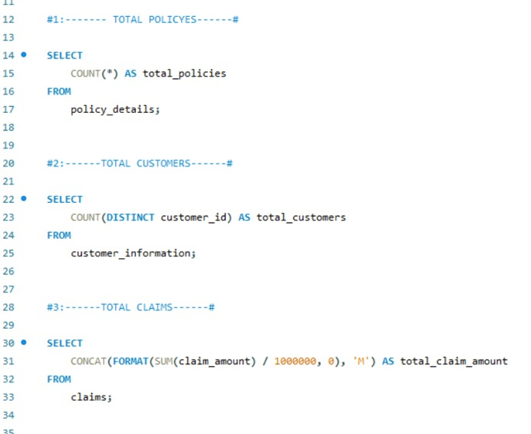
MYSQL QUARIES

Slide 12
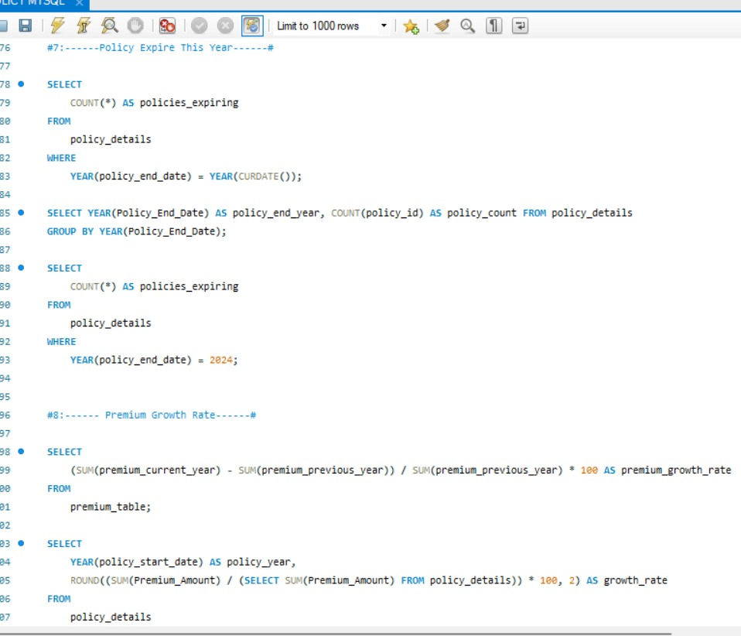

Slide 13
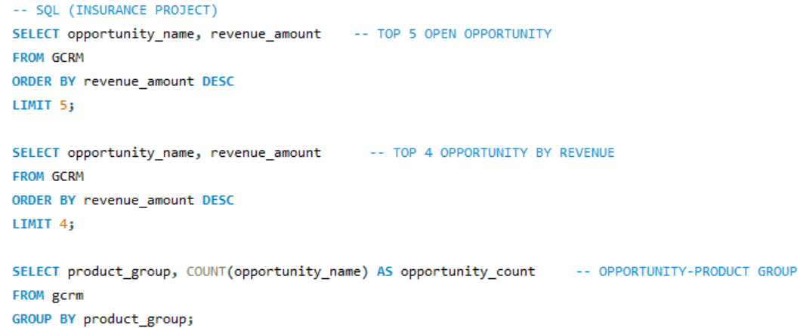
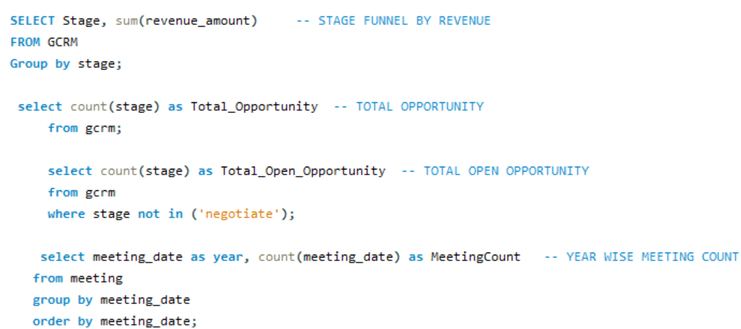

Slide 14
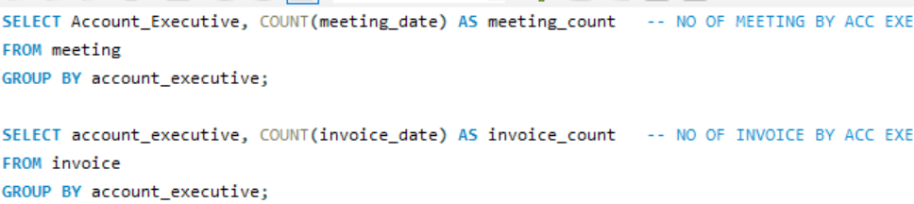
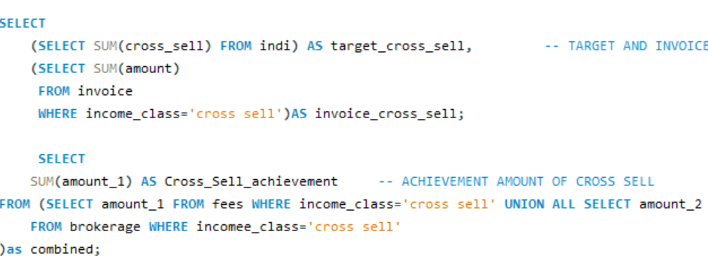

Slide 15
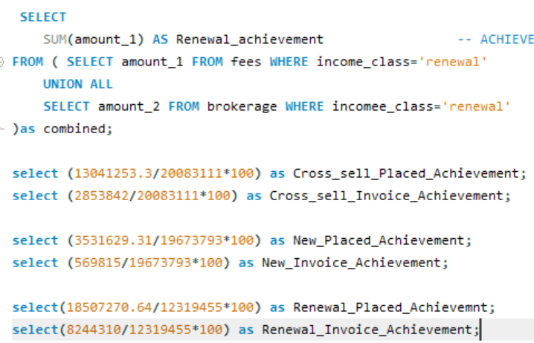

Slide 16
Key Insights
1. Performance of Account Executives:
Abhinav Shivam leads in client engagement with 7 meetings, while Mark and Raju Kumar have only 2 meetings each.
Divya Dhingra processes the highest number of invoices (58), mostly renewals, showcasing her expertise in client retention.
2. Revenue Funnel Bottleneck:
Majority of revenue (59,195K) is in the "Qualify Opportunity" stage, but only 60K reaches the "Propose Solution" stage, indicating a blockage in advancing deals.
3. High Revenue-Generating Policies:
"Fire" policy leads with 500K in revenue, followed by "DB-Mega Policy" at 400K. These policies are significant contributors to revenue.
4. Decline in Client Engagement:
A sharp drop in meetings from 2019 (31 meetings) to 2020 (3 meetings), signaling the need for re-engagement strategies.
5. Opportunities by Revenue:
Policies like "DS-Employee GMC" and "FM-Group Medical" show untapped potential and require further exploration.

Slide 17
Strategic Recommendations for Improvement
1. Targeted Training:
Provide training for low-performing account executives (e.g., Mark, Raju Kumar) to improve client engagement and meeting frequency.
2. Funnel Optimization:
Address bottlenecks in the sales funnel to ensure more opportunities advance from "Qualify Opportunity" to "Propose Solution" stages.
3. Focus on High-Performing Policies:
Prioritize resources for high-revenue policies like "Fire" and "DB-Mega Policy," while promoting cross-selling within these categories.
4. Client Re-Engagement:
Develop re-engagement campaigns to regain momentum in client interactions, particularly to address the decline seen in 2020.
5. Explore Untapped Opportunities:
Investigate and develop strategies to capitalize on underperforming policies such as "DS-Employee GMC" and "FM-Group Medical."
6. Mentor for Retention Strategies:
Leverage Divya Dhingra’s expertise in renewals to mentor other executives in client retention and cross-selling techniques.

Slide 18
Conclusion
1. Summary of Insights:
The dashboard highlights key performance areas, including top account executives, revenue bottlenecks, and high-performing policies.
Opportunities for improvement lie in enhancing client engagement, optimizing the sales funnel, and exploring untapped policy potential.
2. Strategic Path Forward:
Implement targeted training, prioritize high-revenue policies, and address sales funnel inefficiencies.
Develop re-engagement strategies to boost client interactions and revenue conversion rates.
3. Impact:
By acting on these recommendations, the organization can enhance revenue generation, improve client retention, and capitalize on growth opportunities.

Slide 19


